Slide 1
Society in the Age of COVID
Examining COVID-19 in Relation to Prominent Issues:
Relationships of Demographics, Social Gatherings and Vaccinations
COVID Analytics, University of Chicago
Rami Fetouh, Connie Frank, Peter Pezon, Whitney Schreiber

Slide 2
Agenda
Team Introduction
Executive Summary & Research Objectives
Data Profile
Database Design
Reporting & Insights
Reflection

Slide 3




Meet the Team
Rami Fetouh
10 years of experience across investment banking, private equity and corporate finance
Student MScA Program - University of Chicago
BBA University of Michigan, MBA University of Chicago
Connie Frank
4 years of experience as a consultant with Workday Human Resource Management
Student MScA Program, University of Chicago
BA Economics, Butler University
Peter Pezon
10+ years across data and software engineering in public transit, news media and music industry.
University of Chicago
Student in MScA Program
University of Florida
B.S. Electrical Engineering
Whitney Schreiber
2 years of experience as an analyst for a media agency
University of Chicago
Student in MScA Program
Purdue University
B.S. Economics
B.S. Finance
B.S. Marketing

Slide 4
Executive Summary & Research Objectives

Slide 5
Executive Summary
Since the beginning of 2020, the COVID-19 pandemic has had catastrophic effects in nearly every area of business, society, healthcare, and government. How do we know when the “new normal” can go back to the “old normal”?
Our intent is to create a data and analytics platform to organize and analyze COVID trends impacting the spread of the virus, including:
Social gatherings, such as campaign rallies and organized protests
Vaccination mobilization efforts
Socioeconomic factors
The pipeline will intake data from a variety of sources, clean and combine them into a relational database model, and connect to analysis & visualization tools

Slide 6
Research Objectives and Use Case
The diverse set of data inputs for this COVID analytics project can support a wide range of decision-making functions – both private and public – in relation to important metrics such as cases, vaccinations, vaccine-hesitancy and the impact of large gatherings on the spread of the virus
Additionally the datasets incorporate socio-economic factors which can be used in understanding the impact of various factors on prominent trends related to COVID in the United States
The following presentation uses the COVID trends data and analytics platform for policy makers to make decisions based on historical trends related to the aforementioned areas
Decisions such as when / where to open, segments of the population who are under-vaccinated related to the rest of the population, challenges in vaccine acceptance as well as the trend correlation between social gatherings and the spread of the virus
The consolidation of a relatively broad range of data sets in the database is a step forward given some of the complexity in understanding the spread of the virus and efforts taken to address it

Slide 7
Data Profile & Collection

Slide 8





Data Sources
Geographic boundaries
FIPS codes for county, state, metropolitan statistical areas (MSA) and combined statistical areas (CSA).
Source: Census Bureau TIGER
Covid-19
Individual-level patient-level case surveillance that is aggregated to the county level. Variables include case onset, testing results, outcome, geography, gender, age group, and time period.
Source: Johns Hopkins University Center for Systems Science & Engineering COVID-19 Data Repository, Package by Tableau and hosted on data.world
Demographics
Population characteristics by county include total population, population density, average household size, age, race, ethnicity, income, total population that worked at home, etc.
Source: Census Bureau American Community Survey (ACS)
Social Gatherings and Disorders
Events of social gatherings and disorders in the United States from Jan. 2020 to present, with one observation per event at the granularity level of date and U.S. county. Events include associated actors and estimated crowd sizes and foot traffic patterns.
Sources: Armed Conflict Location & Event Data Project (ACLED); Crowd Counting Consortium (CCC)
Vaccination Pulse Survey
Survey of U.S. households on their vaccination status and vaccination hesitancy, summarized by demographic characteristics, at the state geographic level, and weekly.
Source: Census Household Pulse Surveys (HHP) (Table 5. “COVID-19 Vaccinations, by Select Characteristics”)

Slide 9
Data Sources COVID-19 Outcomes
Data sources:
COVID-19 Data Repository by the Center for Systems Science and Engineering (CSSE) at Johns Hopkins University
Packaged by Tableau and hosted on data.world
Reference: Dong E, Du H, Gardner L. An interactive web-based dashboard to track COVID-19 in real time. Lancet Infect Dis; published online Feb 19. https://doi.org/10.1016/S1473-3099(20)30120-1.
Scope of data:
Count of positive cases, deaths, new positive cases and new deaths
One row per day per county (US)
Collection:
Extract data from .csv file and transform into data frames in Python
Transformations:
Data repository transformed by Tableau
Rename column headings to match overall data model
Matching rules:
County FIPS code as county_id
Variables:
Positive Cases Count
Death Count
New Positive Cases Count
New Deaths Count
County Name
County FIPS Number
State Name
Date
Volume:
~ 1.8 million records
502 days measured
Over 1,000 distinct counties
Velocity:
Daily refresh

Slide 10
Data Sources Social Gatherings and Disorders
Data sources:
Armed Conflict Location & Event Data Project (ACLED)
Reference: Raleigh, Clionadh, Andrew Linke, Håvard Hegre and Joakim Karlsen. (2010). “Introducing ACLED-Armed Conflict Location and Event Data.” Journal of Peace Research 47(5) 651-660. www.acleddata.com​.
Crowd Counting Consortium. https://countingcrowds.org
Scope of data:
Events of social gatherings and disorders in the United States from Jan. 2020 to present, with one observation per event at the granularity level of date and U.S. county.
Events include associated actors (e.g., BLM, para-militias, police forces, etc.); and estimated crowd sizes.
Collection and transformations:
Datasets are curated by editorial staffs and finalized after a period of time. CCC is finalized after 6 months.
After initial ingestion, updated events must be merged with events that are already ingested.
Normalize locations to US FIPS codes and MSAs with spatial join on geocoordinates
Normalize date and time encoding (e.g., YYYY-MM-DD); event type codes across datasets
Impute missing data: mismatching crowd counts and missing estimated size
Merging ACLED and CCC events and actors
Matching rules:
Event geo-coordinates to FIPS and MSA
ACLED and CCC: FIPS, date and ACLED source (ACLED sources events from CCC)
Matching with Covid datasets: date and FIPS
Matching with Census datasets: FIPS
Matching with HHP datasets: State and MSA FIPS and survey collection end date.
Analysis:
Social disorder vs. Vaccine hesitancy
Event Crowd Size vs. Case/Death statistics
Case/Death statistics lagged 2-4 weeks: compare before and after event
Difference of conditions: county case rate vs. state case rate.
Detailed views: different types of events, sizes, affiliations
Variables:
Date
Location (FIPS and MSA)
Event type
Protest type
Actors and Actor Type
Issues
Causes
Valence
Estimated crowd size
Arrests
Injuries
Property damage
Volume:
ACLED: 23k samples, 30 attributes
CCC: 10-30k samples, 30 attributes
Velocity:
ACLED updated daily.
CCC updated weekly (Wednesday 4PM EST).

Slide 11
Data Sources Vaccination Pulse Survey
Data sources:
Census Household Pulse Surveys (Table 5. COVID-19 Vaccinations, by select characteristics)
In 2021, the U.S. Census began publishing COVID data as part of its Household Pulse Survey
The report is still in the experimental phase and does not appear to have an API
Scope of data:
Survey of U.S. households on their vaccination status and vaccination hesitancy, summarized by demographic characteristics, at the state geographic level, and weekly.
Characteristics: Age group, gender, race, household income, etc.
Geographic data: Region (National, state, metropolitan statistical area)
Temporal data: Week
Matching: Matching done through FIPS codes and dates
Collection: Utilize Python to extract relevant information from CSV files and convert to data frames, which feed into the overall data pipeline for the project
Transformations:
Web scraping and selection of data from Census website
Crawl weekly index of surveys
Parse HTML for content area; table description and links to workbooks
Parsing multi-dimensional Excel workbook
Each worksheet is a region
Conforming rows of characteristics and columns of questions and responses across surveys
Variables:
Week
Region
Survey
Response Table
Content Area
Demographic/Characteristics
Question
Response
Volume:
10-100k thousand samples
Content Area: 5 subjects
Survey Tables: 20 tables per content area
Questions: 1-3 per table
Responses: 3-5 per question
Characteristics: 50-100 per table
Velocity:
New survey tables weekly

Slide 12
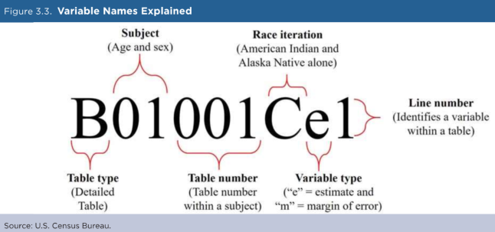
Data Sources Demographic Variables
Data sources:
Census Bureau’s API for American Community Survey (ACS)
Updated annually from the ACS’s newest 5-year data [last updated in April 2021]
Scope of data:
Population characteristics are by county with one observation per county.
Matching rules:
ACS datasets can be matched to other data streams by county name and state name
Table universe and variable name details require mapping
Transformations:
Population percentages will need to be calculated for variables given as county ‘total’
Collection:
Utilize R to transform column IDs to easy-to-understand variable names, extract relevant fields, and calculate population percentages. Join ACS tables based on FIPS codes.
Variables:
Population Density
Total Population
Population 65+ Living in Group Quarters
Average Household Size
Percent of Households with Income Below Poverty Level
Income to poverty ratios
Percent of Households Receiving Food Stamps/SNAP
Total Households by Income Level
Race and ethnicity
Gender
Age
Total Population that Worked at Home
Volume:
3,220 counties
Aggregate data from 8 ACS tables
Velocity:
American Community Survey results published annually

Slide 13
Database Design

Slide 14
Design Considerations: Platform
Type of application:
Dataset Ingestion:
Application backed by transactional database store
Cloud Function ingest and transform open-source datasets
Scheduled background process; available at scheduled time.
Reporting Dashboard:
Application supported by analytic data warehouse and BI tools
Transformations to subject-area facts and dimensions tables
Aggregations to daily, weekly time scales; county, state geographic scales
Data format and size:
Data sources: CSV, Excel, HTML, HTTP API
Data is relational and tabular
Small-to-medium sized datasets (10-100k)
Geospatial data: events
Graph data: Events and Actors
Number of users and locations:
Tens of report users
Focused on United States
County-level where possible; MSA; state-level otherwise
Schedule and budget:
Costs: Budget SKUs: low memory, low CPU
Policy: Shut down resources if not in use
Timeline: 2 months
~20-40 hours/week
1 month design; 1 month development
Resource budgeting: 4 part-time engineers/scientists
Hardware and software:
Infrastructure: Google Cloud Provider (GCP)
Database: Google Cloud SQL
Reporting: Tableau
Application: Google Cloud Function
Ingestion: Google Cloud Scheduler/PubSub
Maintenance and support:
Non-critical data and dashboards
Low volume/velocity data
Security and privacy:
Open-sourced public datasets

Slide 15
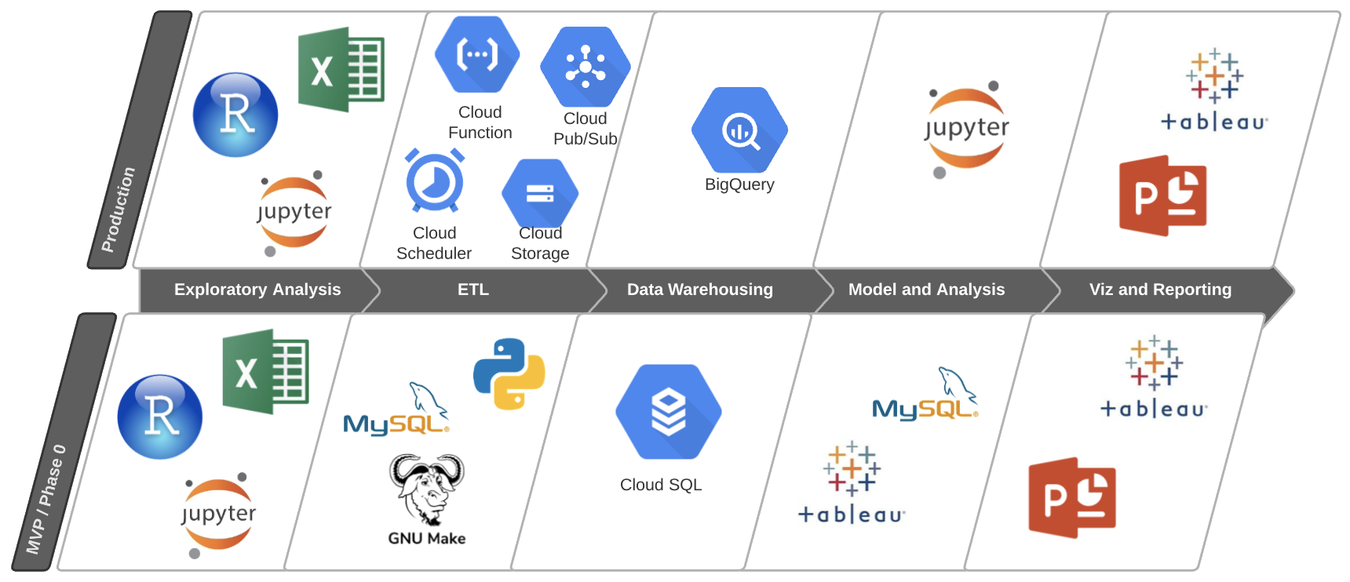
Platform
Objectives:
Single source of truth
Reduce errors
Improve analytical robustness
Additional tools:
Github: code and documentation

Slide 16
Design Considerations: ETL and Data Preparation
Programming:
Python and R scripts to download and transform datasets
SQL scripts to transform once inside database: stored procedures and triggers
Data pipeline steps:
Load reference tables: date, county, state, MSA, CSA
Ingest data sources into Cloud SQL tables on a schedule (script per data source)
Standardize dataset entities (Census Characteristics; Social Gathering Datasets)
Transform database tables into facts and dimensions; using stored procedures and triggers
Covid-19 Cases
Calculate case rate and death rates (7-day average)
Calculate case rate and death rate per-capita
Demographics
Map table universe to variable names
Calculate population percentages
Social Gatherings and Disorders
Standardize actors, events and event types across ACLED and CCC: deduplication and matching
Vaccination Pulse Survey
Survey responses: workbooks is organized by state and is in a survey-response format
The process to collect the data will utilize Python to extract the relevant information from CSV files and convert to dataframes which fed into the overall data pipeline for the project

Slide 17
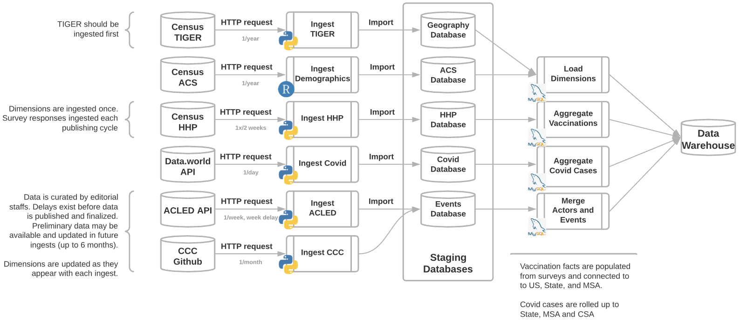
ETL and Data Processing

Slide 18
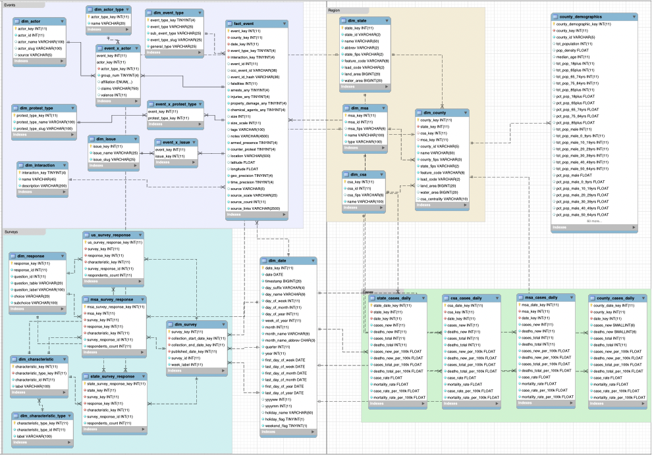
Reporting Data Warehouse Entity Relationship
Multiple subjects: snowflake model
County-level facts:
Case and Mortality Counts
Demographics (Annual)
Social Disorder Events
State-level facts:
Vaccination by Characteristics (Weekly)
Vaccine Hesitancy by Characteristics (Weekly)
Dimensions:
Geographic areas: County, State, MSA, CSA
Time periods: Date
Slowly changing dimensions: Demographics
Subject-specific reference dimensions
Rolled ups to facilitate joining across subjects:
Covid Cases for State, MSA, CSA
Views to facilitate analysis:
Data lags
Excess case rate (county vs. state)
Vaccination headline numbers
Vaccination hesitancy reasons

Slide 19
Insights, Reports, and Dashboards

Slide 20
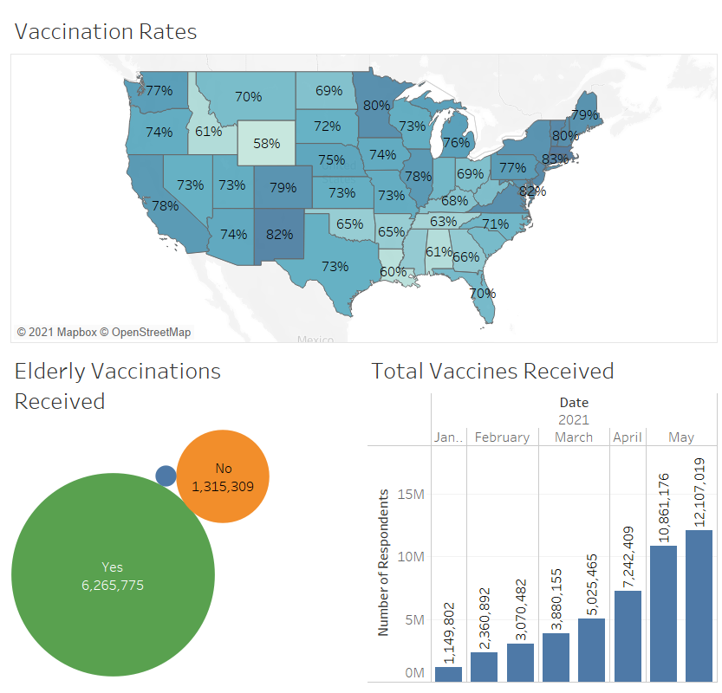
Florida Case Study: Vaccinations
Relatively moderate vaccination rate
High proportion of elderly received vaccines
Slowing down of vaccine deliveries

Slide 21
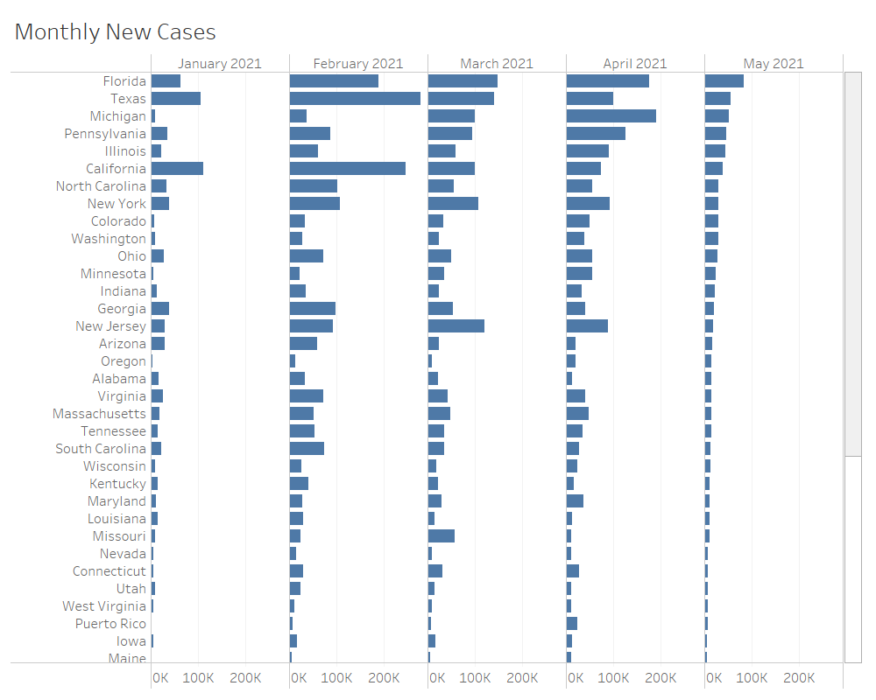
Florida Case Study: Cases Trend
Consistently high number of cases
Other regions like California, New York and Jersey have experienced larger declines in case rates from historically high levels

Slide 22
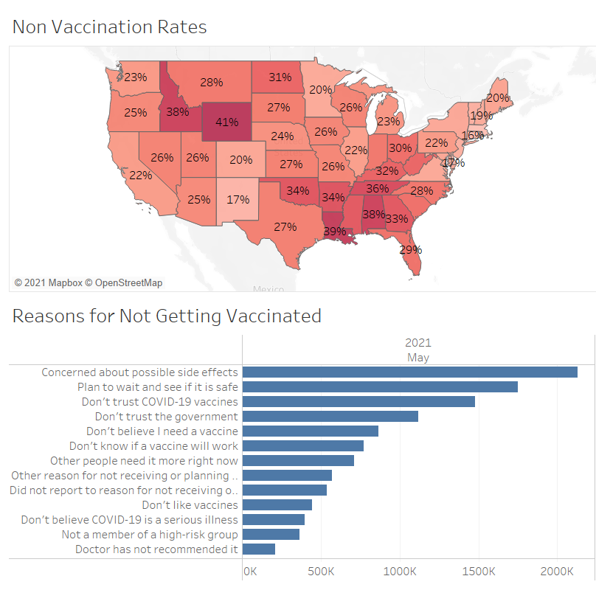
Florida Case Study: Non-Vaccinated Overview
Reasons for not getting vaccinated involve trust of vaccines and government

Slide 23
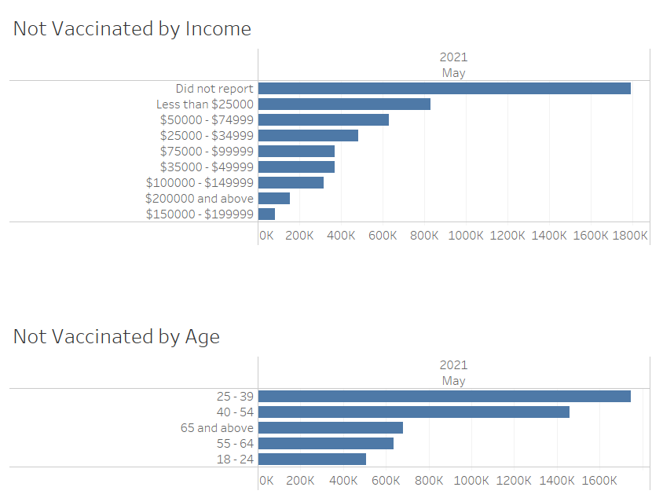
Florida Case Study: Not Vaccinated by Demographic
Dichotomy of vaccinations compared to income levels
Largest number of non-vaccinated individuals are young adults

Slide 24
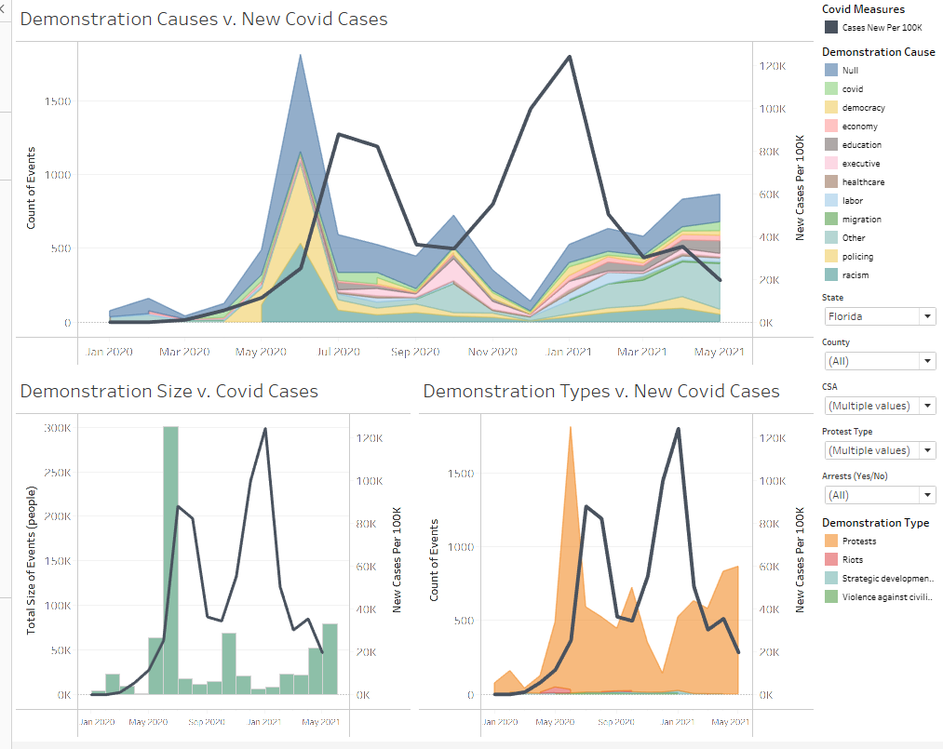
New Covid Cases v. Events View of Demonstrations and Covid-19 metrics
Filter by State, County, or CSA
Isolate event types, time periods, event purpose

Slide 25
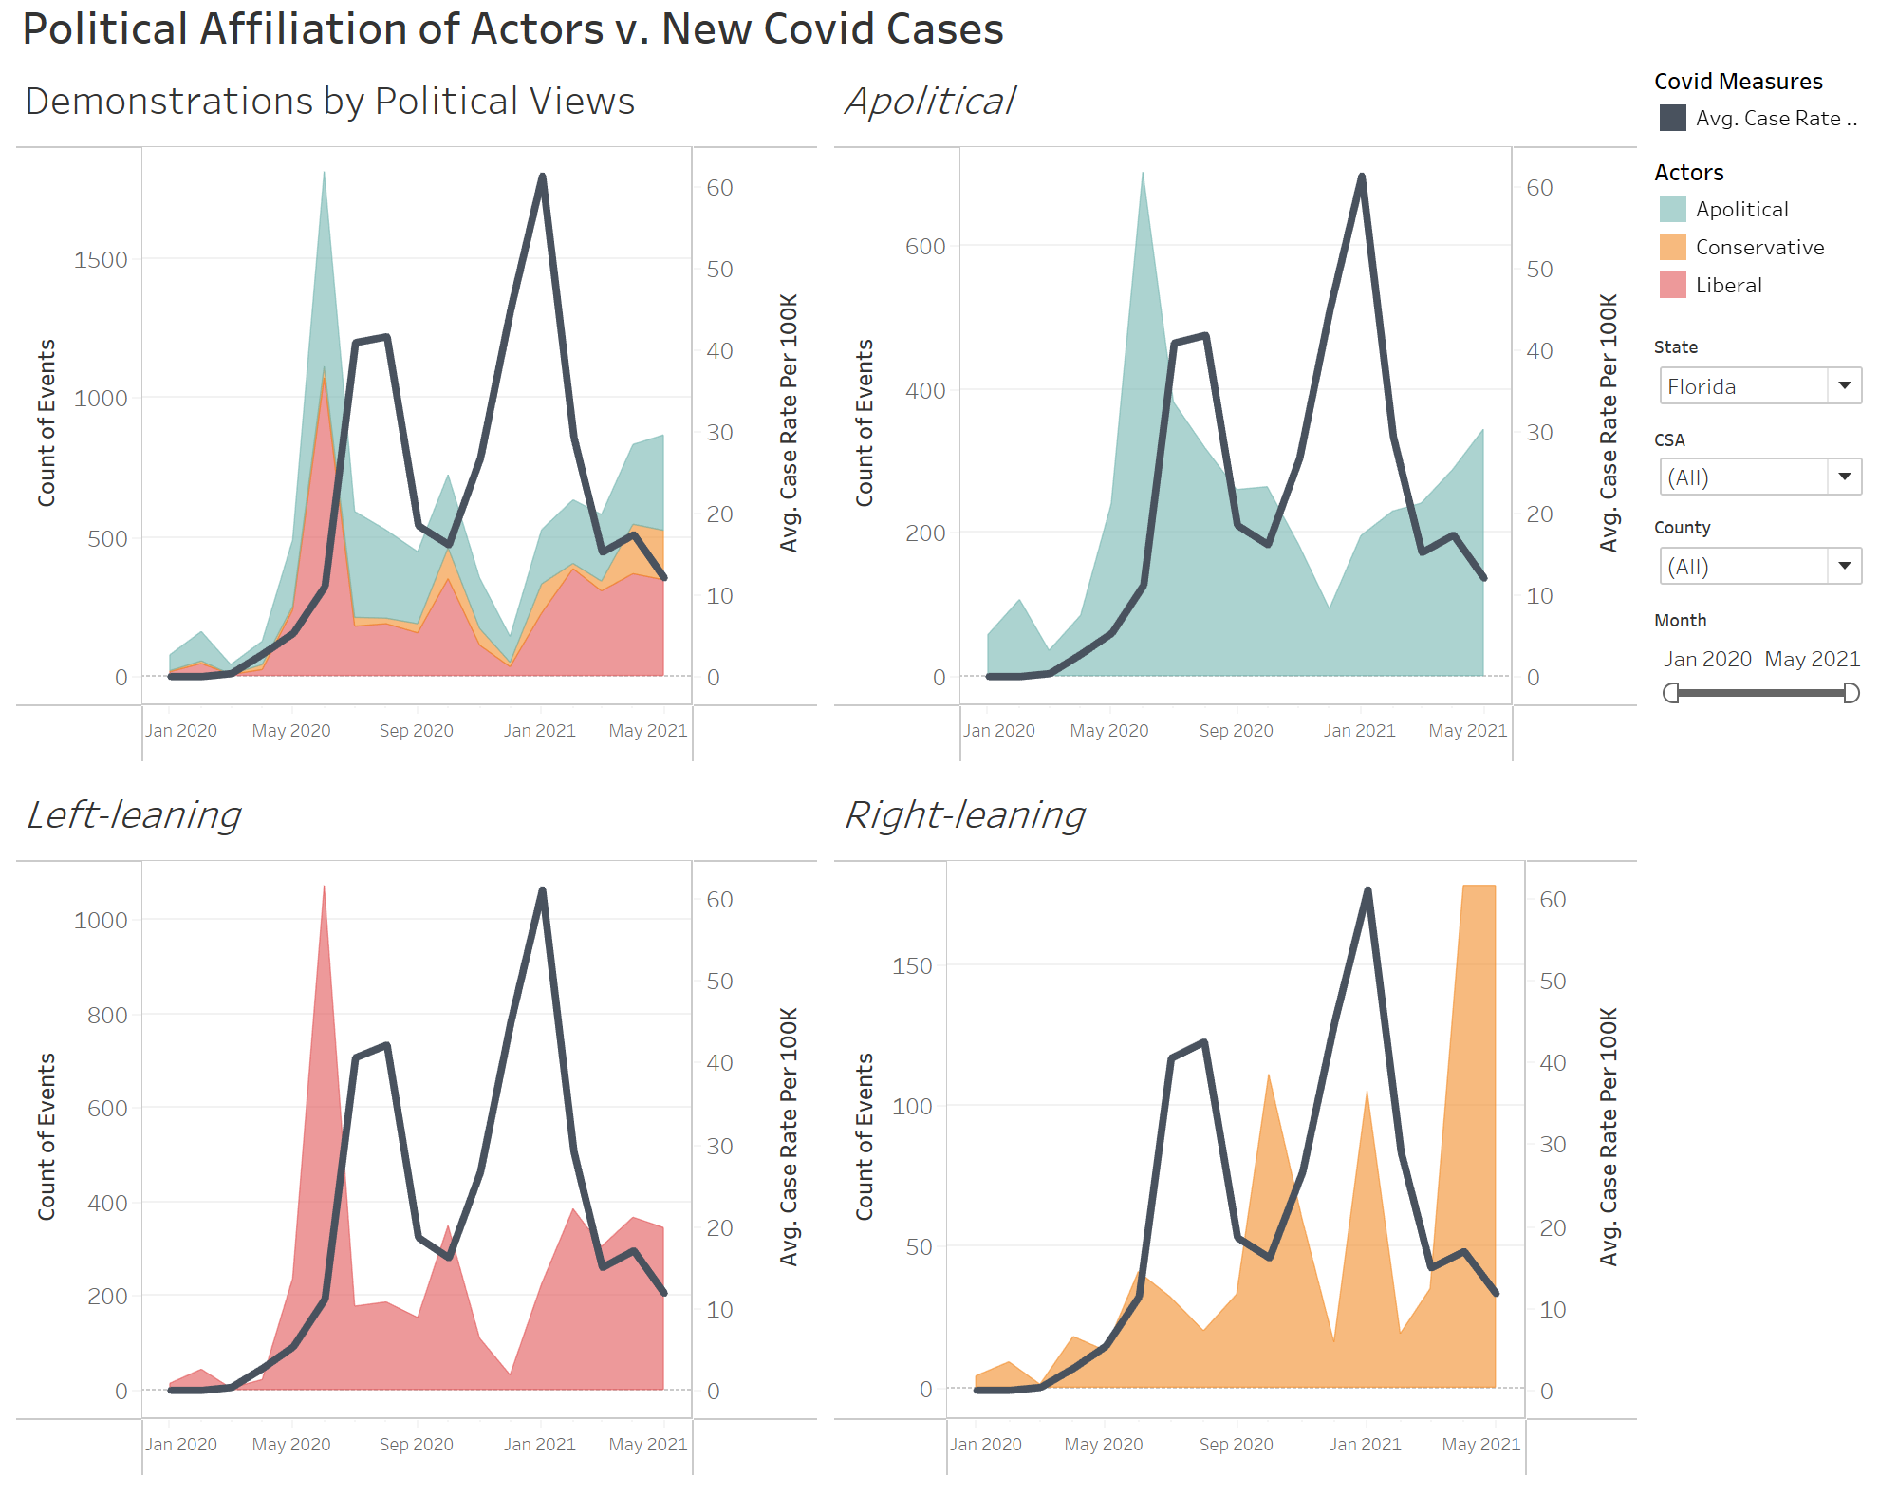
New Covid Cases v. Events View Covid-19 metrics and Demonstrations by Political Affiliation
Filter by State, County, or CSA

Slide 26
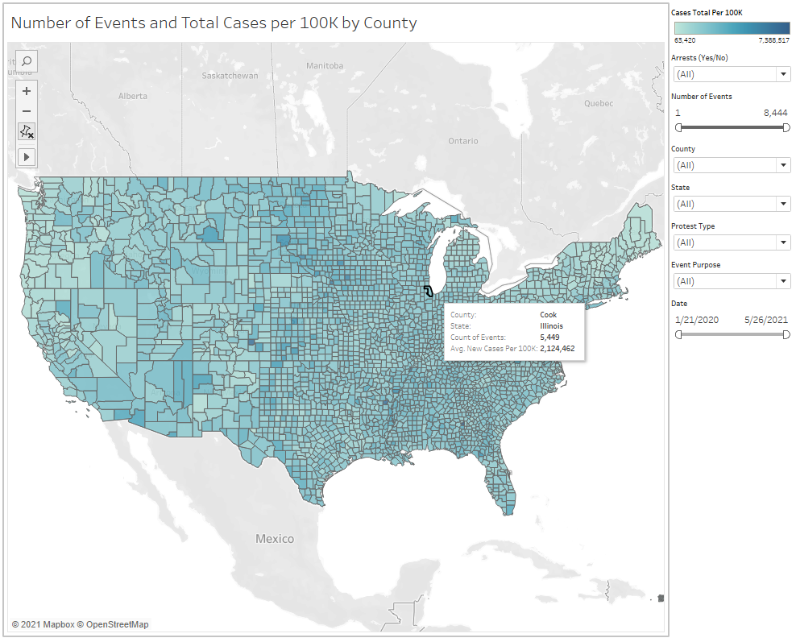
New Covid Cases v. Events County Level View of the Number of Events and New Cases
Color scale of average new cases per 100k
Overlay of number of events in county
Filter by State, County, or CSA
Isolate event types, time periods, event purpose

Slide 27
Recommendations & Lessons Learned

Slide 28
Recommendations
Incorporate additional data sources
Complete Covid-19 case data: Access to CDC Restricted Access Case Surveillance datasets
Additional Covid-19 datasets: hospitalization and testing statistics
Additional Census ACS characteristics: Education {schooling online v. in-person}, transportation
Additional Census Household Pulse Survey tables with generic HHP survey ingestion system
Additional types of public gatherings, i.e., concerts, sporting events
Alternatively: general mobility (foot traffic) datasets (e.g., SafeGraph) instead of demonstrations
Public sentiment: social listening / media and news coverage
Political factors: Election and political valence data
Cleaning and preparation of datasets:
Clustering to normalize events and actors and assign political valence
Automate data collection and refreshing dashboard and reports
Additional applications and analyses:
Shortest paths of least resistance for spread of infectious disease (using Neo4J)
Directly comparing effects of public health policies of adjacent counties
Leveraging NoSQL data stores for unstructured data (e.g., text analysis of event data or public sentiment)

Slide 29
Lessons Learned & Scope for Improvement
Much easier to gather more information upfront and not use it as opposed to patching up later
Importance of thinking through how different data sets connect with one another for integration
Understanding dynamics related to COVID are not one-dimensional. There are a lot of factors to be taken into consideration
Although some of the latest data that is available can still be in test mode, the effort in collecting this less-structured data can be more than worth it in developing new insights
Ability to leverage summary views to simplify SQL queries
Smaller / more narrow Tableau data sources to improve performance and simplify OLAP models and reports
In data collection sometimes have to make tradeoffs between breadth and depth (e.g. state vs. county-level information)

Slide 30
Appendices

Slide 31
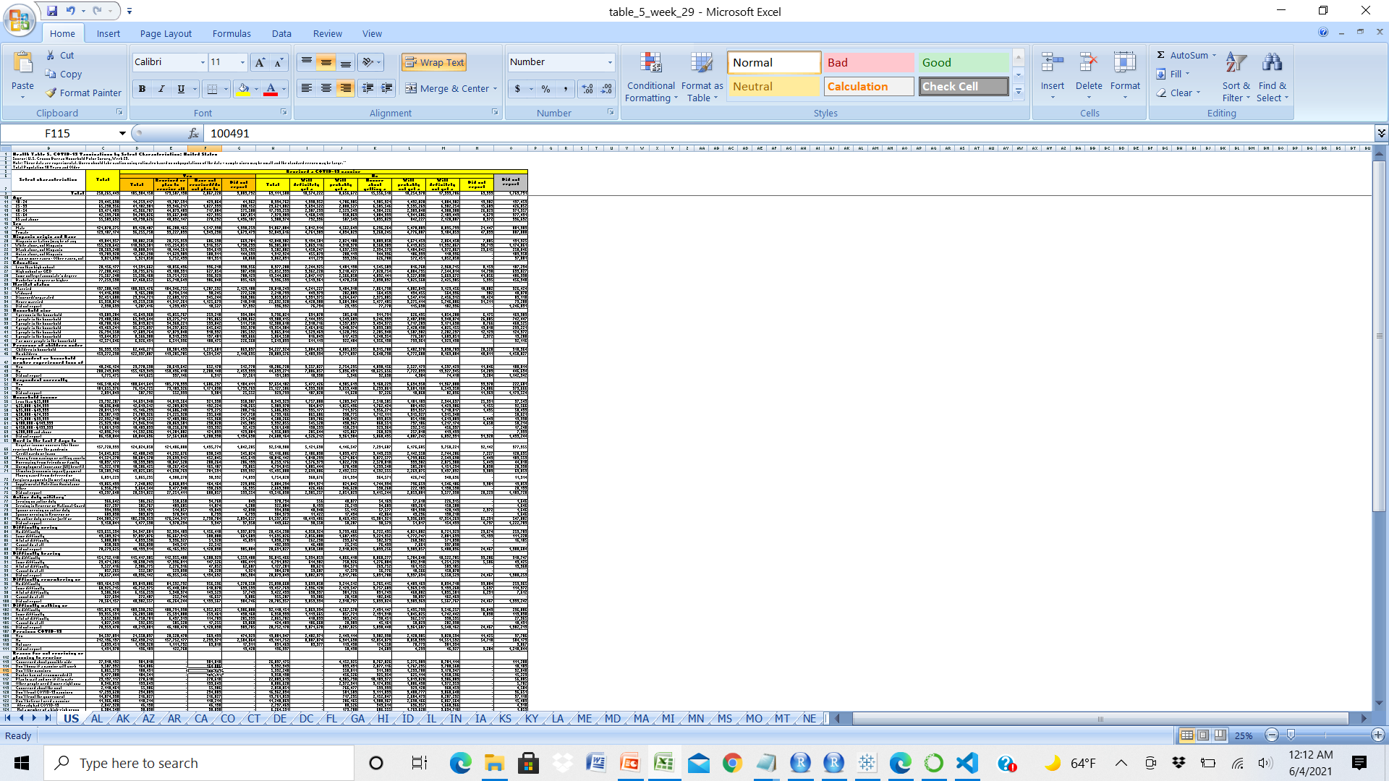
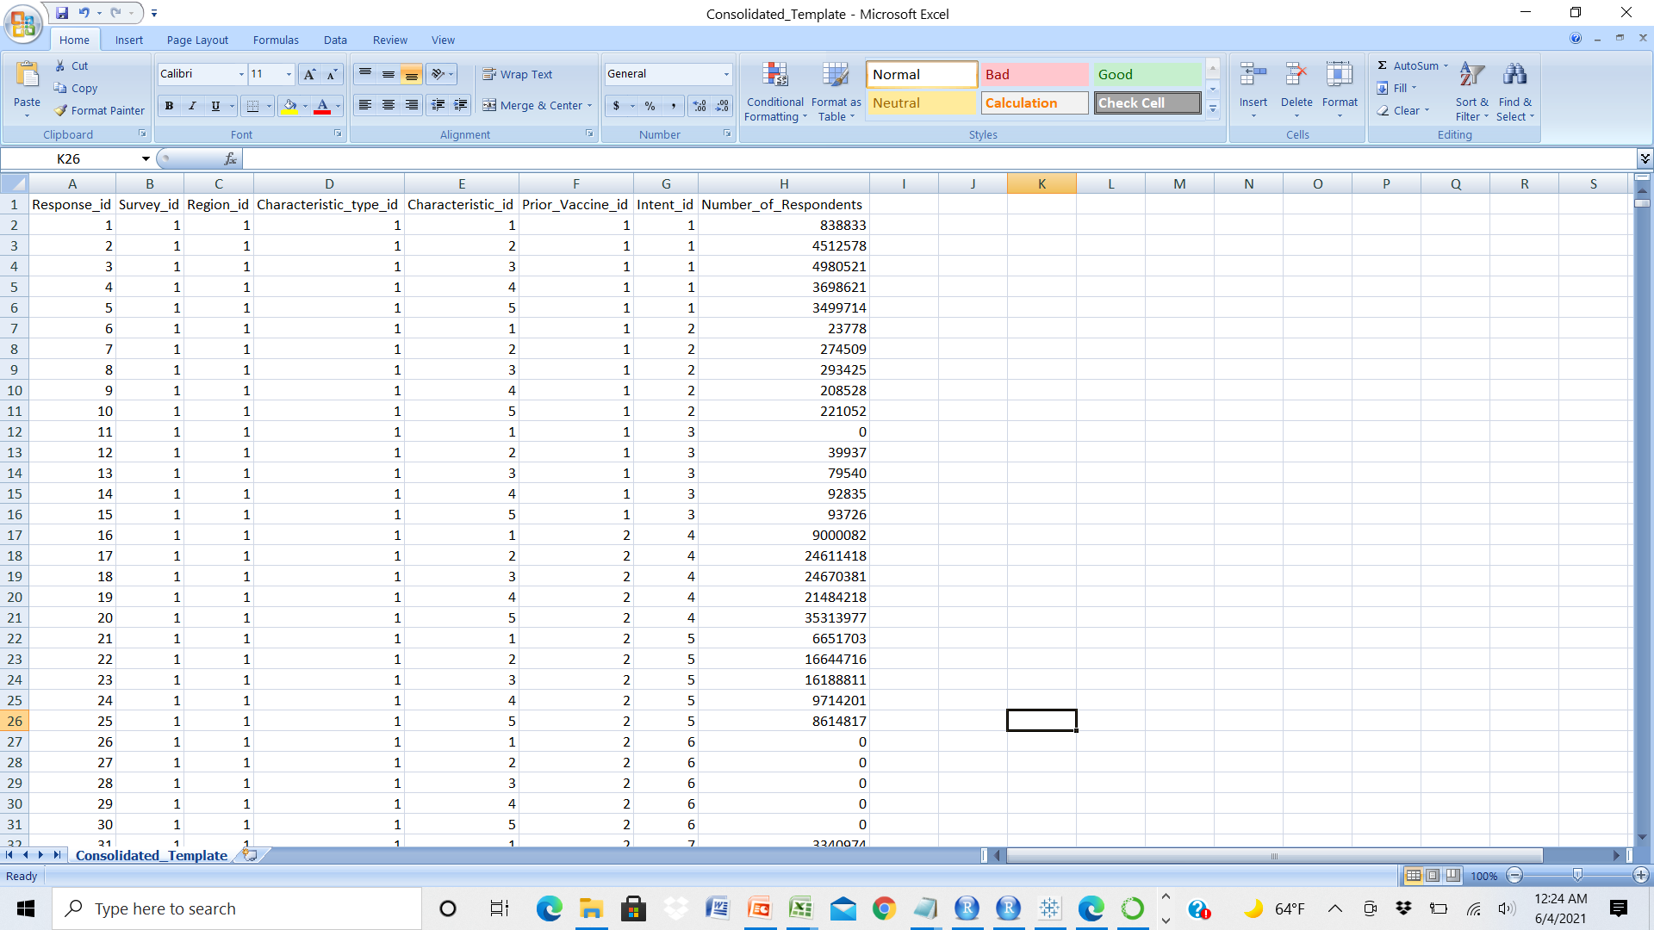
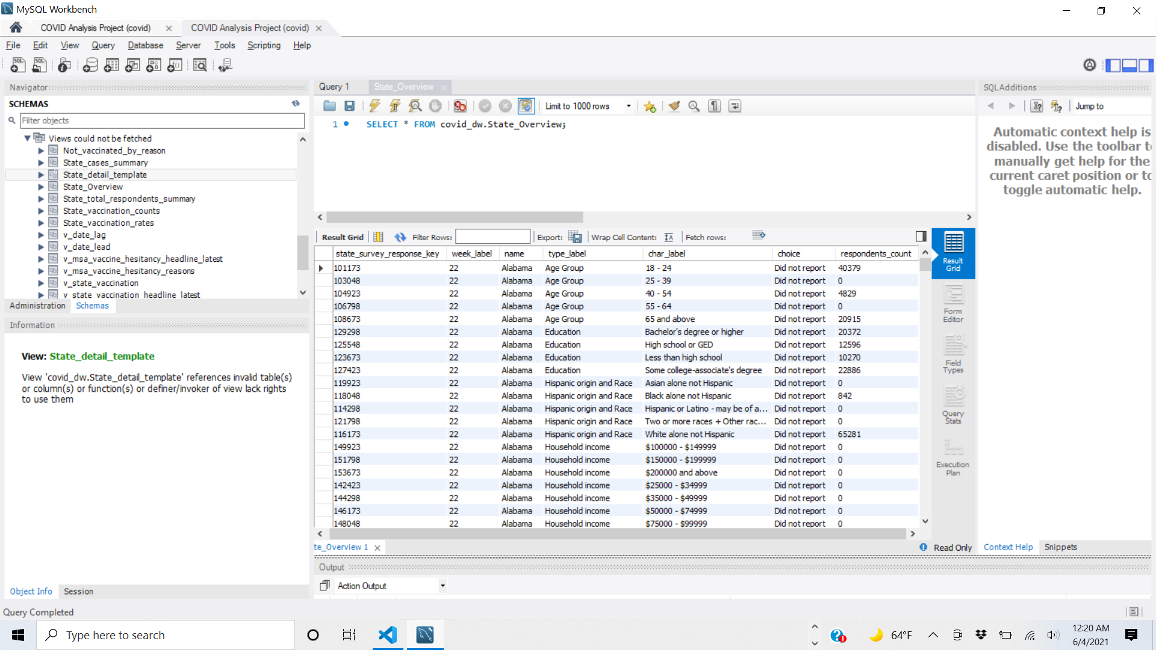
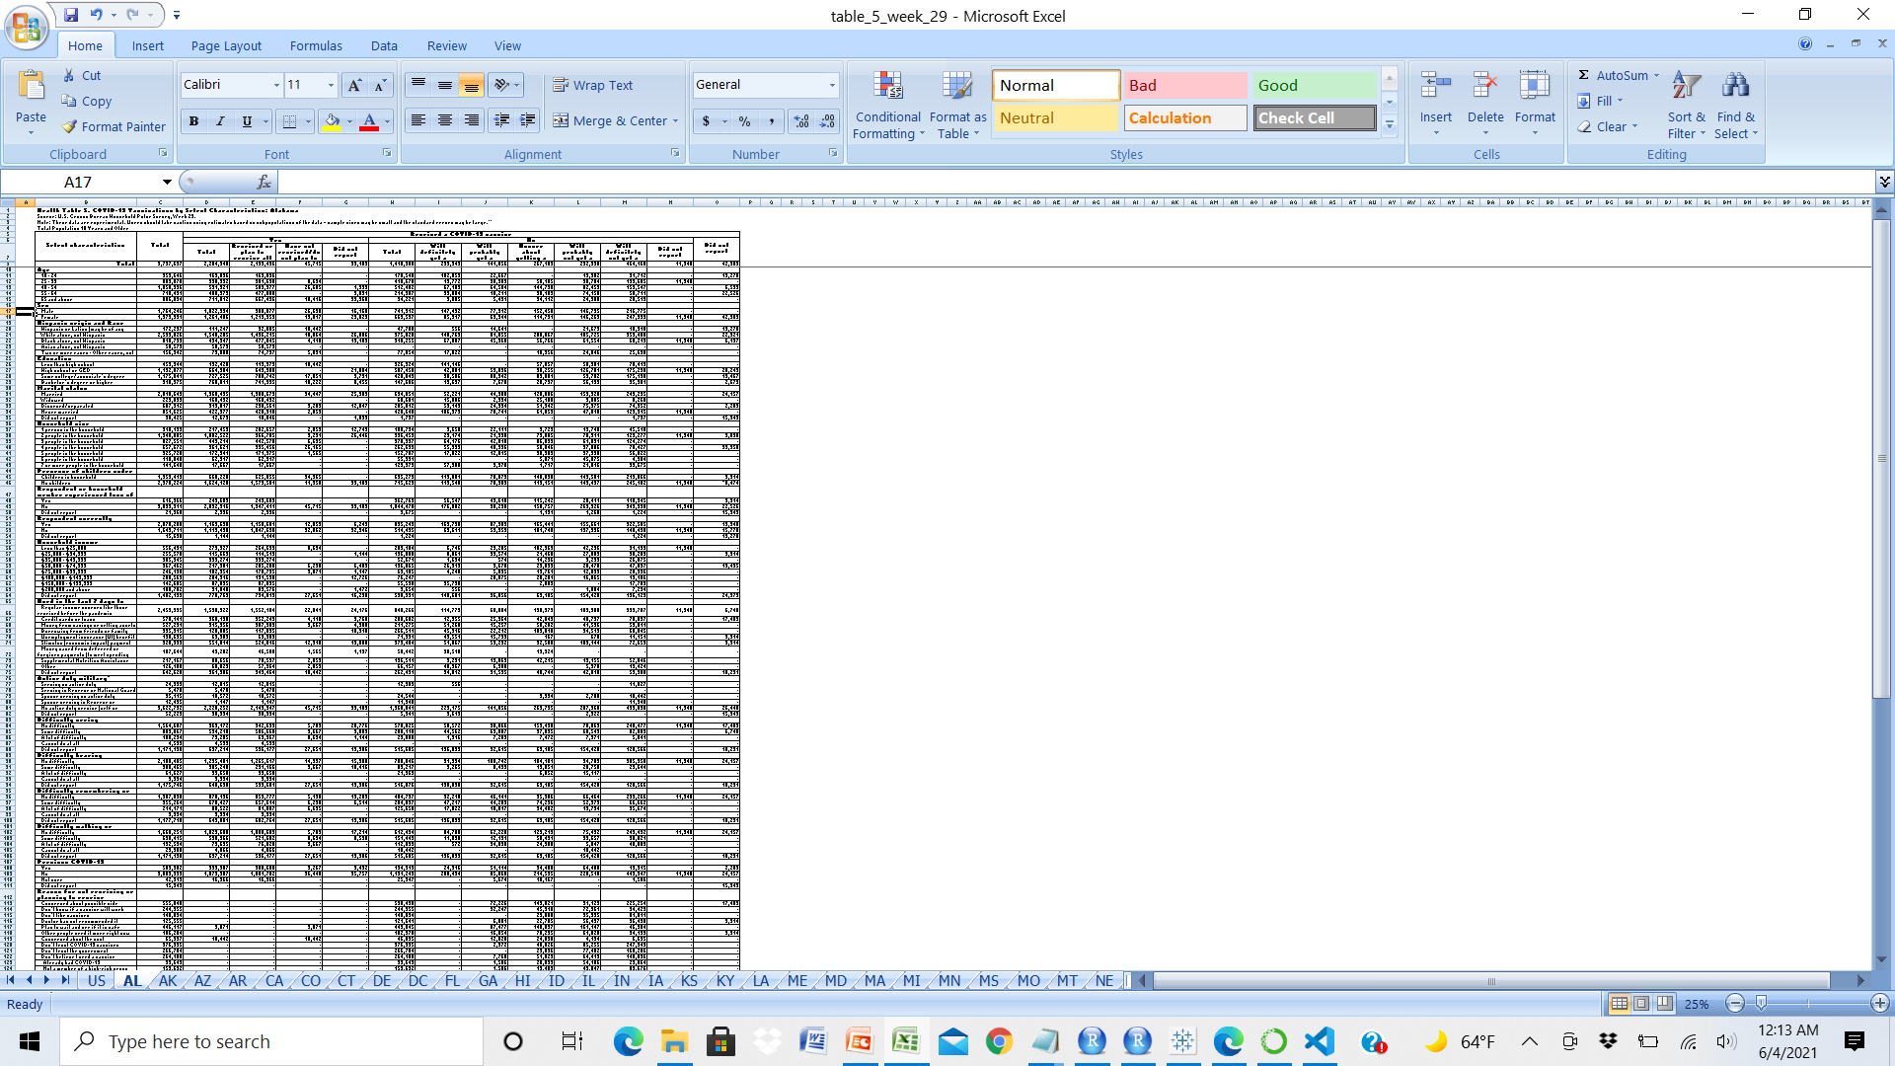
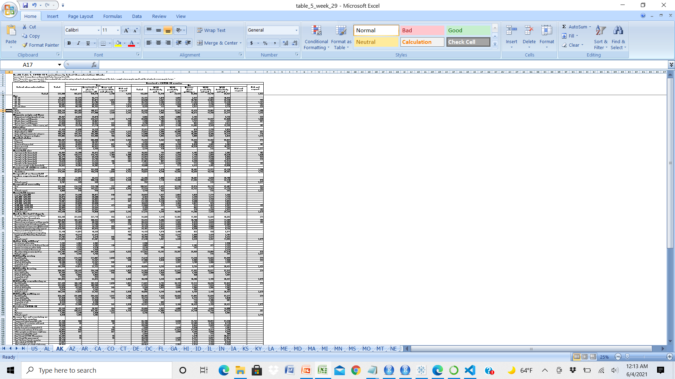
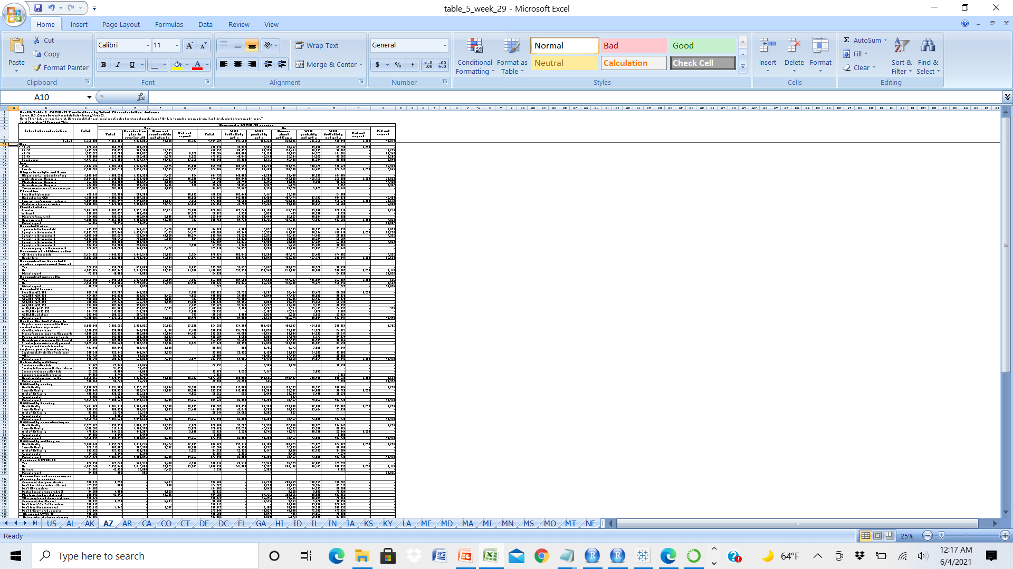

Vaccination Dataset Process Overview
Pulse Survey CSVs
Mapping of Dimensions
Internal Database
Web scraping / file transformations
Columnar key for Python dataframe
Internal database leveraging views

Slide 32
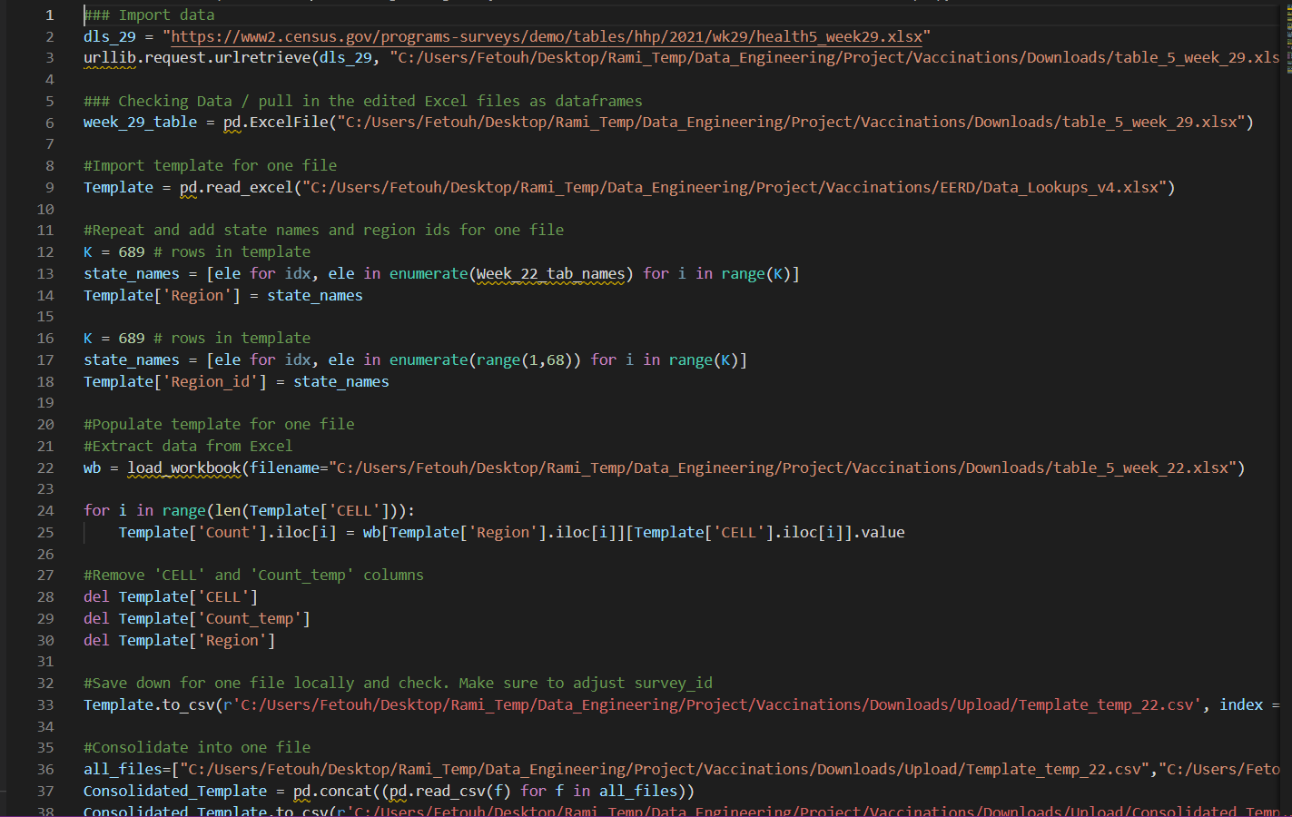
Vaccination Dataset Sample Python Code

Slide 33
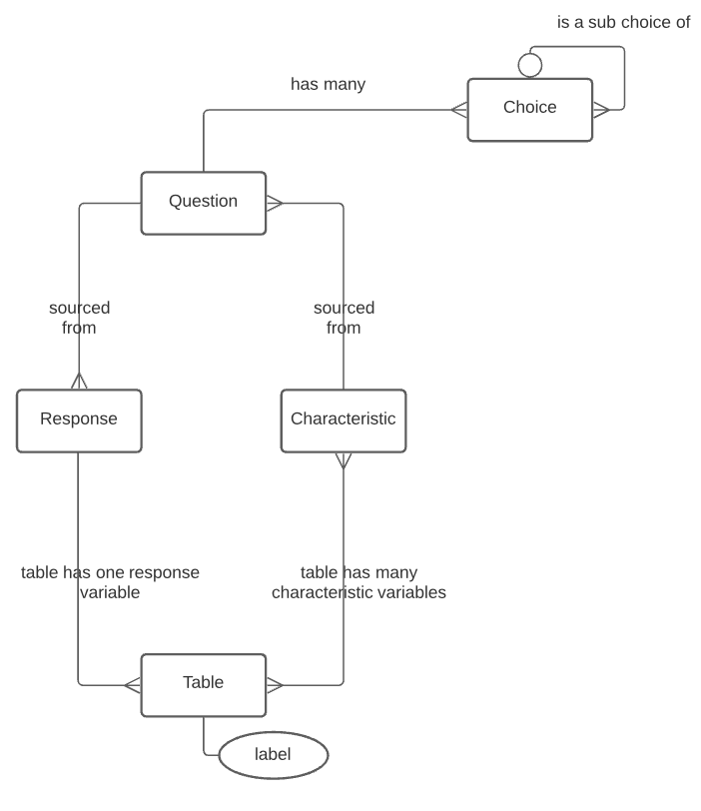
Entity Relationships Census Household Pulse Survey

Slide 34
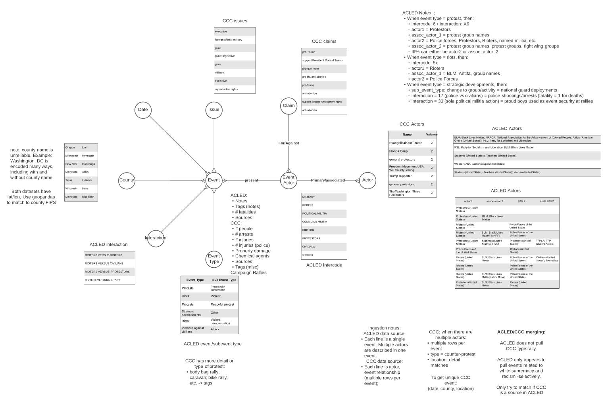
Entity Relationships Social Disorder and Demonstration Events

Slide 35
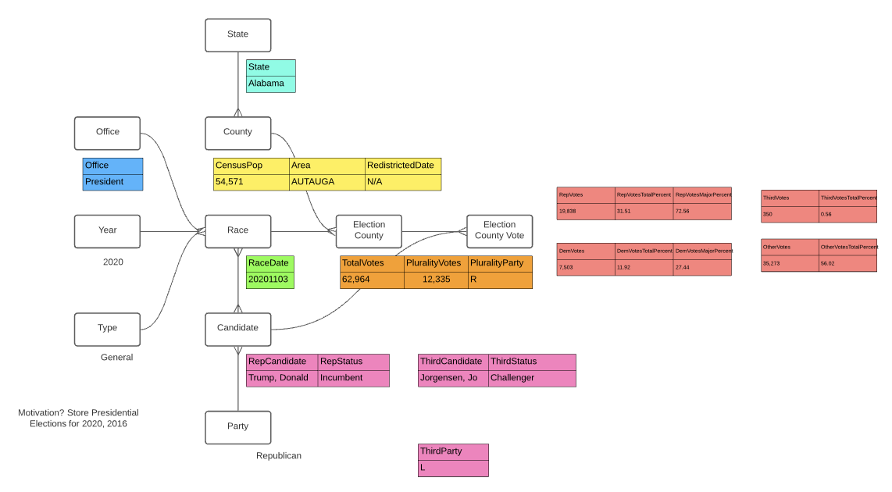
Entity Relationships 2020 U.S. Elections

Slide 36
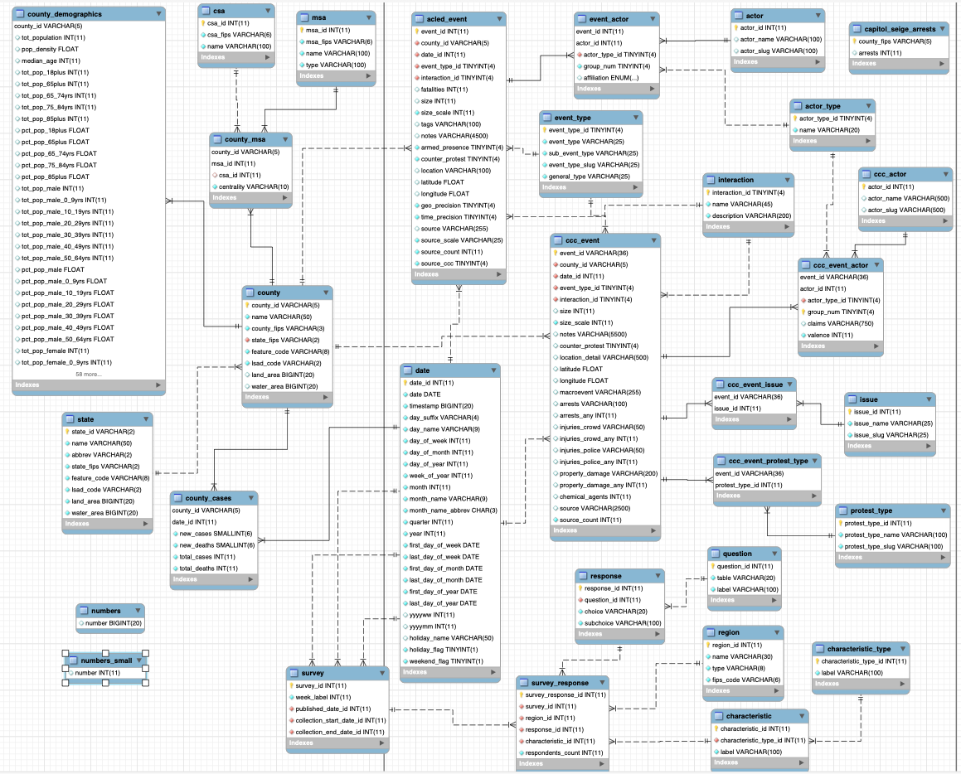
Data Model Staging Database EERD

Slide 37
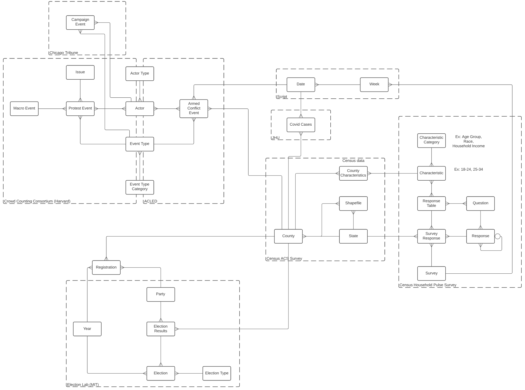
Transactional Database - Entity Relationship
Snowflake model with multiple subjects
County-level facts:
Case and Mortality Counts
Demographics (Annual)
Election Results
Political Party Registration
Social Gathering Events
State-level facts:
Vaccination by Characteristics (Weekly)
Vaccine Hesitancy by Characteristics (Weekly)
Dimensions:
Geographic areas: County, State
Time periods: Date, Week, Year
Slowly changing dimensions: Demographic, Political Party Registration
Subject-specific reference dimensions
Rolled ups to facilitate joining across time periods:
Covid Case State Weekly Summary
Census Demographic and Household Surveys:
Survey question responses by characteristics
Responses can be broken down to more detailed responses
Multiple characteristics in table
Worksheets for each region
Data shared among multiple datasets
Geographic: County, State
Time period: Date, Week, Year
Characteristics: County Census, Survey
Event: Actor, Actor Type, Event Types

Slide 38
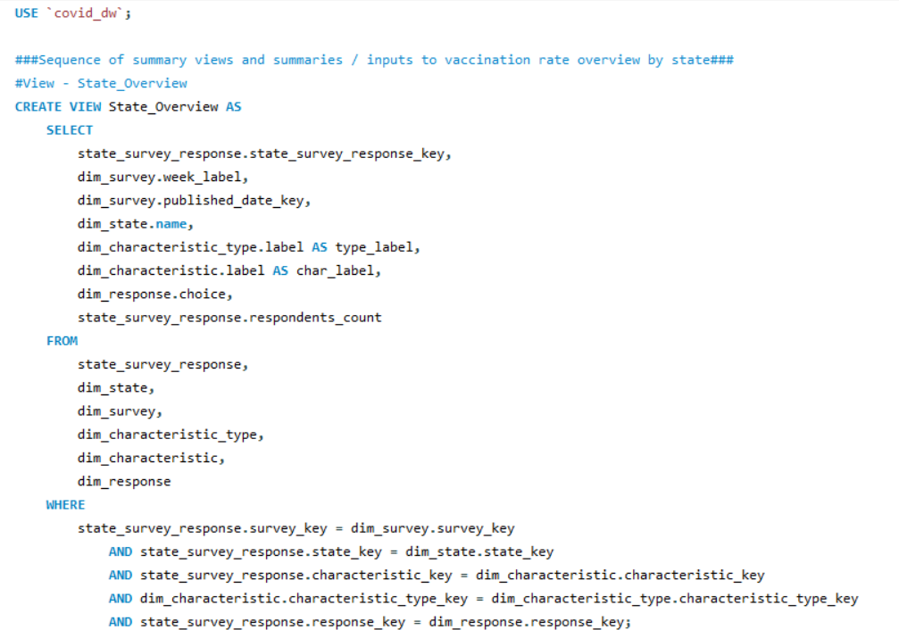
SQL Views Sample Queries - State_Overview

Slide 39
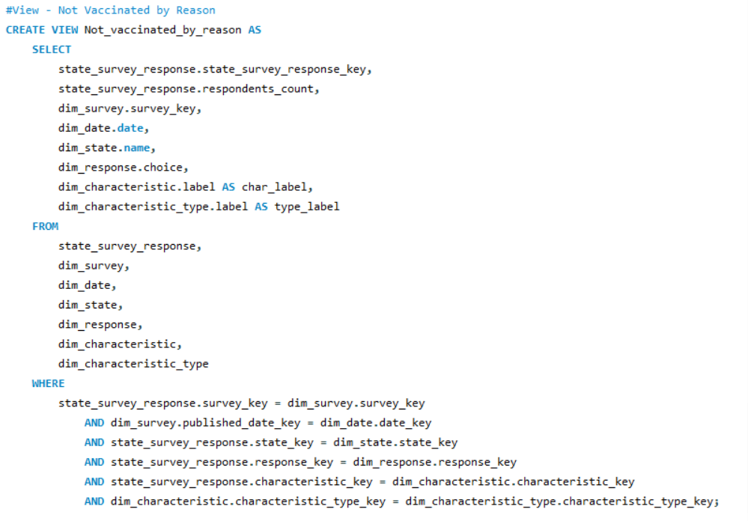
SQL Views Sample - Vaccination Choice Reasons

Slide 40
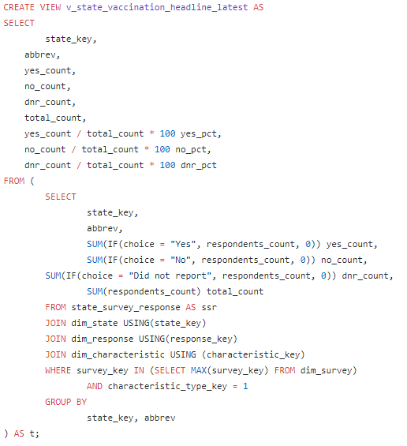
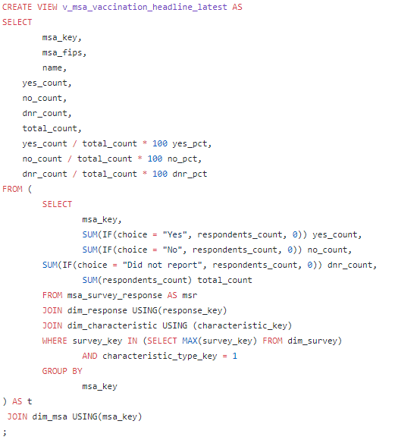
SQL Views Sample Queries Vacination Headline - Latest
State granularity
MSA granularity

Slide 41
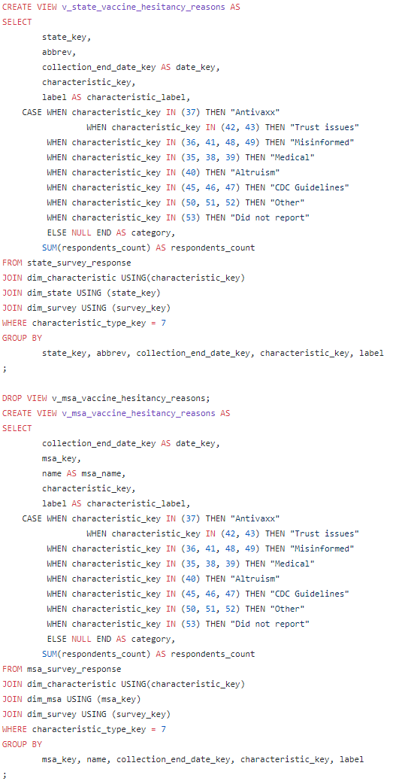
SQL Views Sample Queries Vacination Hesitancy Reasons
State granularity
MSA granularity

Slide 42
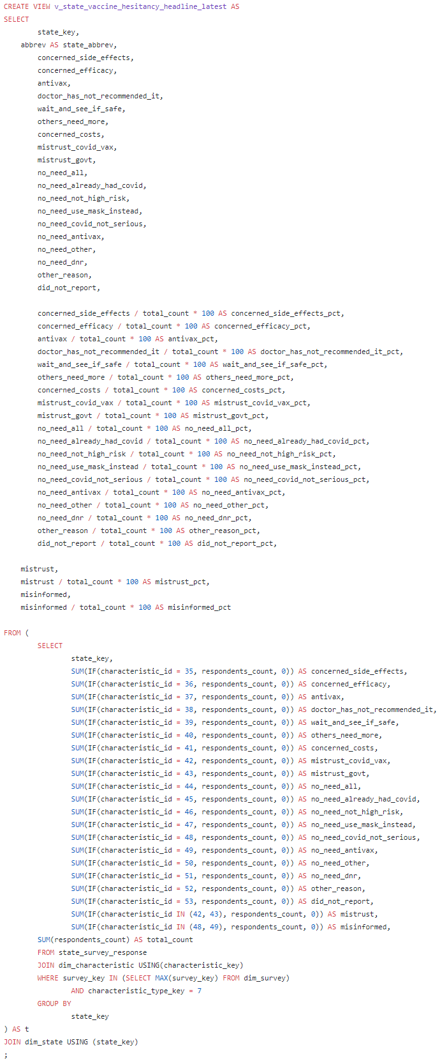
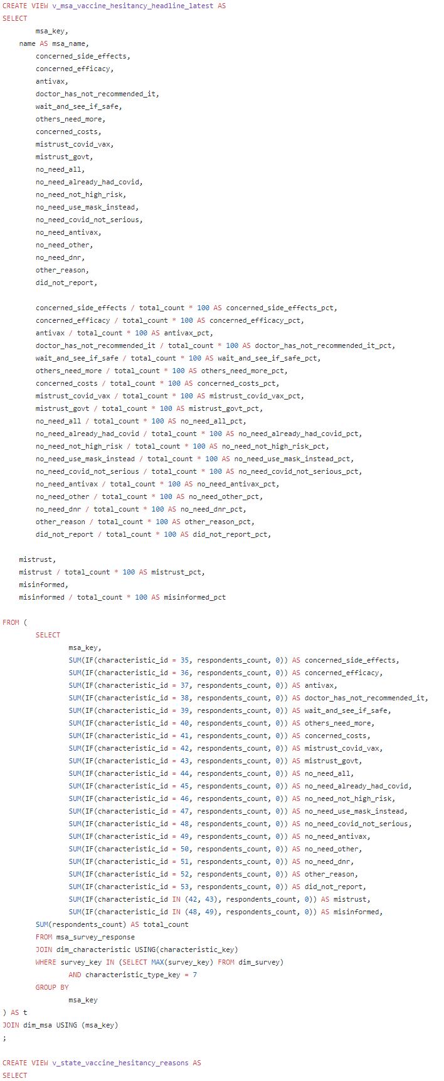
SQL Views Sample Queries Vacine Hesitancy Headline - Latest
State Granularity
MSA Granularity

Slide 43
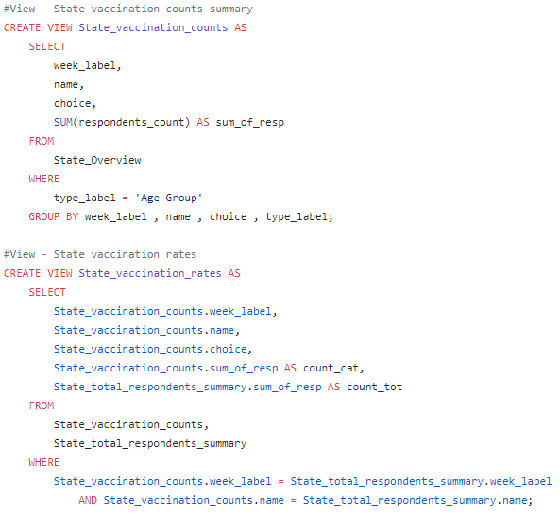
SQL Views Sample Queries State Vacination Progress
State Vaccination Counts
State Vaccination Rates

Slide 44
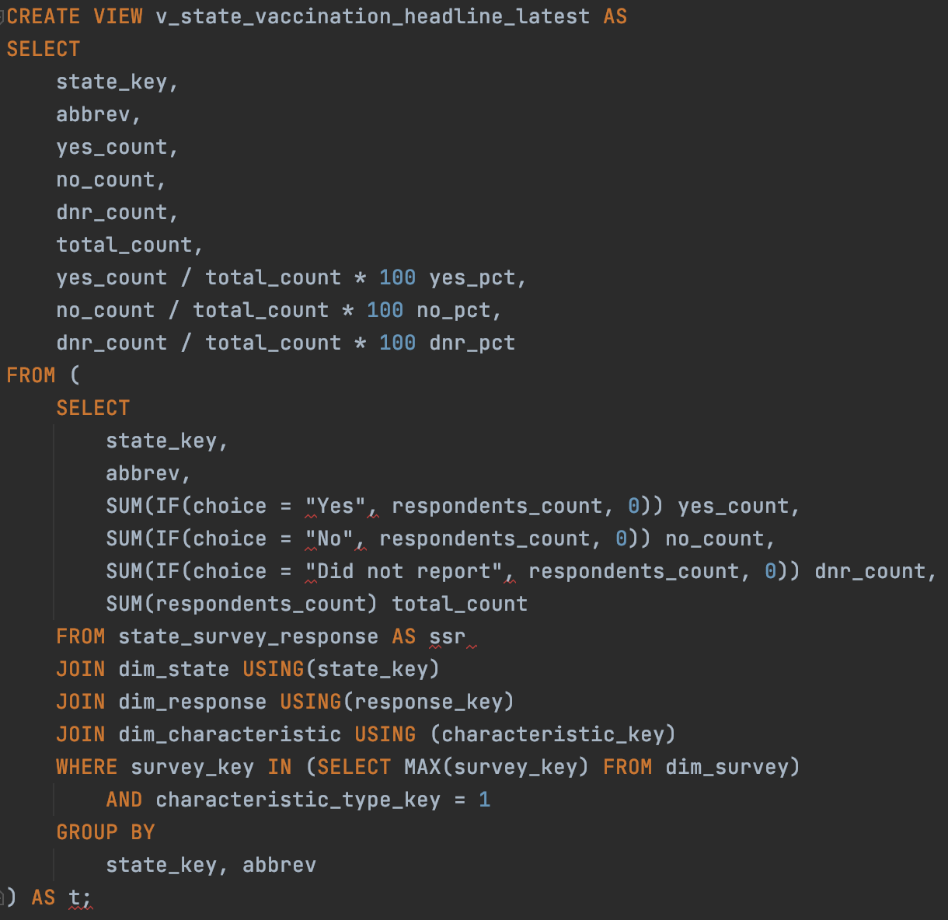
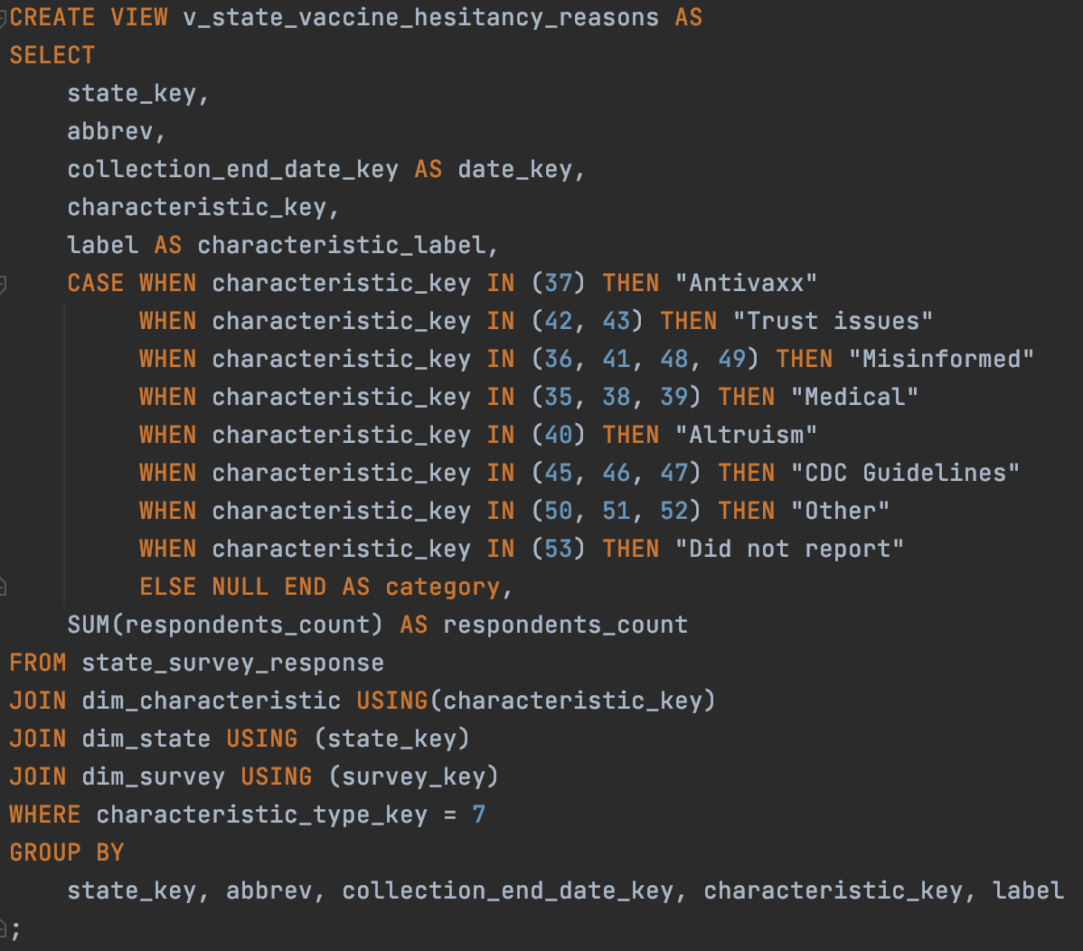
SQL Views Sample Queries Vaccine Hesitancy Reasons Headline
State Vaccination Headlines
State Vaccination Hesitancy

